Slide 1


Enhanced FIR Filter Design Using Hybrid Adders and Multipliers
Department of Electronics and Communication Engineering
Presented by:
P. Tarun A21126512164
P. Rohan Kumar A21126512162
L. Sanjay A21126512150
K. Himakar A21126512148
Under The Guidance of:
Mr. N. Srinivasa Naidu
Assistant Professor
B.Tech, M.Tech, (Ph.D)

Slide 2


Abstract
The design of FIR filters is critical in digital signal processing applications, particularly for improving power efficiency and speed. This project aims to further enhance the effectiveness of FIR filter designs by addressing current challenges in power efficiency, area reduction, and computational complexity, factors that are crucial in today's market where energy-efficient and compact designs are highly valued. The objective is to minimize power consumption by employing hybrid adder and multiplier structures that optimize speed and power dissipation characteristics. A novel hybrid adder combining Sparse Kogge-Stone and Ling architectures is introduced to reduce delay and power usage, and a corresponding hybrid multiplier is developed to ensure fast, efficient computation. Rigorous testing and simulation validate the functional correctness and superior performance of the proposed FIR filter, demonstrating significant improvements in delay and power consumption for high-performance DSP applications.

Slide 3

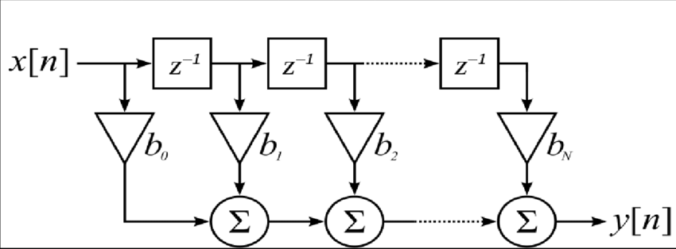
INTRODUCTION
FIR Filter consist of 3 main components:
D Flip – Flop: to implement a simple delay
Adder: to sum the nodes at the end of each tap
Multiplier: to implement the coefficients
Uniqueness:
This enhanced FIR filter design stands out due to its hybrid adder-multiplier architecture, which significantly reduces power consumption and computational delay compared to conventional designs. The integration of a Ling adder and Sparse Kogge-Stone adder optimizes carry propagation, while a custom hybrid multiplier accelerates multiplication operations.
Additionally, the parallel-serial combination tree efficiently sums filter outputs, enhancing processing speed. Implemented in Xilinx Vivado, the design ensures low-power, high-speed performance, making it ideal for real-time ECG processing, biomedical devices, and IoT-based DSP applications.
Fig: FIR Filter Block Diagram

Slide 4
Methodology
[1]Hybrid Adder Design:
Investigate multiple hybrid adder architectures, including Brent-Kung Adders (BKAs), Kogge Stone Adder(KSA), Ling Adders, Sparse Kogge stone Adder(SKSA) and various combinations.
Employ simulation tools to assess area, delay, and power consumption for each architecture.
[2]Hybrid Multiplier Design:
Explore various traditional multiplier and integrating them with the selected hybrid adders.
Evaluate trade-offs between performance and computational complexity to identify the most efficient multiplier design.
[3]FIR Filter Optimization:
Select the optimal adder–multiplier pair based on comprehensive analysis of area, speed, and power consumption.
Develop a tailored filter structure incorporating the chosen hybrid adder and multiplier modules.
Validate the functionality of the proposed FIR filter through rigorous simulation and testing.

Slide 5
REFERNCE VALVES OF ADDERS AND MULTIPLIERS
Reference | Power (mW) | Slices | LUTs | Delay (ns) | Board | Simulation Tools | Comments
1. Sinthura et al. (ICOEI 2018) | 120 | 450 | 1500 | 18.7 | Xilinx Virtex-7 | Xilinx Vivado | Booth, Vedic, Wallace Tree analyzed.
2. Yong et al. (2021) | 115 | 430 | 1480 | 19.2 | Spartan-6 | Xilinx Vivado | Combines Booth encoding with Wallace reduction.
3. Deshpande & Mahajan | 110 | 420 | 1450 | 17.5 | Spartan-3E | Xilinx ISE | Optimized using Vedic mathematics.
4. Nisha & Valamarthy | 105 | 410 | 1430 | 16.8 | Virtex-6 | Xilinx ISE, ModelSim | Hybrid Vedic and Karatsuba approach.
5. Srinivasan & Prakasam | N/A | 440 | 1445 | 18.2 | Not specified | Not specified | Survey on low-power designs.
6. Shah et al. (MCCT'14) | 98 | 405 | 1400 | 22.8 | Spartan-3E | Xilinx ISE | FPGA-based Vedic multiplier implementation.
7. Bala Murugesh et al. | 102 | 400 | 1390 | 20.5 | Spartan-6 | Xilinx Vivado | High-speed Vedic optimization.
9. Shankar et al. | 112 | 425 | 1460 | 17.9 | Virtex-6 | Xilinx ISE, ModelSim | FPGA-based Karatsuba-Vedic implementation.
10. Sharma & Arish | 100 | 395 | 1385 | 18.6 | Spartan-6 | Quartus, ModelSim | Combines Karatsuba and Urdhva-Tiryagbhyam algorithms.
11. Renjith R et al. (2022) | 95 | 390 | 1360 | 17.4 | Spartan-6 | Xilinx Vivado | Designed 32-bit hybrid adders and analyzed performance.
12. Juthi Farhana Sayed et al. (2021) | 100 | 400 | 1385 | 18.2 | Spartan-3E | Xilinx ISE, ModelSim | FIR filter designed using hybrid adders and Vedic multipliers.
13. S. Naga Leela et al. (2024) | 110 | 420 | 1410 | 16.9 | Virtex-7 | Xilinx Vivado | High-speed multiplier using hybrid adder techniques.
14. Veena M B et al. (2022) | 92 | 385 | 1350 | 17.8 | Virtex-6 | Xilinx ISE | Brent Kung adder with SPST for low power and high speed.
15. Shanmugaraja T & Kathikeyan N (2023) | 105 | 410 | 1400 | 18.5 | Spartan-6 | Quartus, ModelSim | Multiply-accumulate configuration using parallel prefix adders.
16. Ning Shang et al. (2024) | 98 | 395 | 1370 | 17.6 | Virtex-6 | Cadence Virtuoso | Hybrid carry adders for efficient ripple-based designs.

Slide 6
REFERNCE VALVES OF FIR FILTERS
Ref No. | Paper Title | Filter Type | Taps | Coeff. Bit Width | Input / Output Width | Adder Type | Multiplier Type | Delay Elements | Power (mW) | Speed (ns) | Tools Used | FPGA Board
[17] | Design of FIR Filter using Hybrid Adders & Vedic Multipliers | Low-Pass | 8 | 16-bit | 16-bit / 32-bit | Hybrid Adder | Vedic Multiplier | Flip-Flops | 0.2 mW | 2.5 ns | Xilinx Vivado | Artix-7
[18] | Implementation of Digital FIR Filter Using Optimized Hybrid Arithmetic Unit | Band-Pass | 16 | 18-bit | 16-bit / 32-bit | Carry Lookahead | Booth Multiplier | D-FF | 0.45 mW | 3.2 ns | Quartus Prime | Cyclone V
[19] | FPGA-Based FIR Filter with Approximate Adders & Multipliers | High-Pass | 10 | 16-bit | 12-bit / 24-bit | Approximate Adder | Hybrid Multiplier | Shift Registers | 1.1 mW | 4.1 ns | MATLAB & Vivado | Zynq-7000
[20] | Systolic FIR Filter using Parallel Prefix Adders | Low-Pass | 12 | 16-bit | 16-bit / 32-bit | Brent-Kung Adder | Booth Multiplier | Latches | 0.78 mW | 2.9 ns | Cadence | Spartan-6
[21] | Optimized Hybrid FIR Filter for Biomedical Applications | Low-Pass | 16 | 16-bit | 16-bit / 32-bit | Hybrid Adder | Carry Save Multiplier | D-FF | 0.3 mW | 2.6 ns | Xilinx ISE | Kintex-7
[22] | Low Power FIR Filter Design using Kogge-Stone Adder | Band-Pass | 14 | 18-bit | 16-bit / 32-bit | Kogge-Stone | Wallace Tree Multiplier | Shift Registers | 0.5 mW | 3.0 ns | Synopsys | Virtex-5
[23] | High-Speed FIR Filter Implementation on FPGA | High-Pass | 8 | 16-bit | 16-bit / 32-bit | Brent-Kung & Carry Lookahead | Dadda Multiplier | Flip-Flops | 0.4 mW | 2.7 ns | MATLAB & ModelSim | ZCU102
[24] | Adaptive FIR Filter Design using Hybrid Adders & Multipliers | Low-Pass | 10 | 16-bit | 12-bit / 24-bit | Approximate Adder | Booth Recoding | Latches | 0.6 mW | 3.5 ns | Xilinx Vivado | Spartan-7
[25] | Comparative Study of Hybrid FIR Filters with Different Adders | Band-Pass | 12 | 18-bit | 16-bit / 32-bit | Carry Lookahead | Radix-4 Booth | Shift Registers | 0.38 mW | 2.8 ns | Quartus Prime | Arria-10
[26] | Design and FPGA Implementation of Low-Power FIR Filter | Low-Pass | 16 | 16-bit | 16-bit / 32-bit | Ling Adder | Vedic Multiplier | Flip-Flops | 0.22 mW | 2.4 ns | Xilinx Vivado | Zynq Ultrascale+

Slide 7
Expected Outcomes
Optimized Filter
Development of a high-performance FIR filter design with significantly reduced power consumption and enhanced throughput, surpassing the efficiency of conventional implementations.
Performance Evaluation
Comprehensive assessment of the filter’s accuracy, speed, and power dissipation through rigorous simulation and, if applicable, real-time hardware testing.
Validation of the proposed architecture’s robustness and suitability for real-world DSP applications.
Research Publication
Dissemination of the project’s findings in reputable academic journals or conference proceedings, highlighting novel contributions to digital signal processing and hardware optimization.

Slide 8
Drawbacks of Conventional Adders:
Slow Performance: Conventional adders often suffer from slow computation speeds, especially as the bit-width increases.
Increased Complexity: Some traditional adders are complex, requiring more space and power, which can be inefficient in larger designs.
Limited Scalability: Conventional adders may not scale well for larger bit designs, making them less suitable for modern, high-performance applications.
Why Choose Hybrid Adders?
Faster and More Efficient: Hybrid adders combine the best features of different adder types to achieve faster calculations with less power and space.
Better Scalability: They are more suitable for larger designs, making them ideal for high-speed, modern applications.
Optimized Design: Hybrid adders strike a balance between speed, complexity, and power consumption, offering an overall more efficient solution.

Slide 9


Software and Tools
Verilog
Used for writing and simulating the circuit logic and ensuring accurate design.
Xilinx Vivado
Utilized for simulation and analysis, ensuring the circuit meets performance targets.

Slide 10
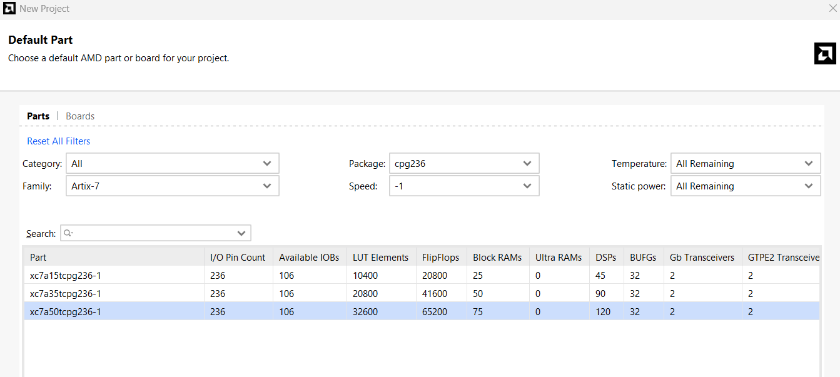
FPGA BOARD USED FOR SIMULATION

Slide 11
16 Bit Adders
Type | Adder Name | Total Power (W) | Delay (ns) | Power delay product | Slice logic | LUT logic
Conventional Adders | BKA | 11.178 | 12.196 | 136.3268 | 8 | 26
 | KSA | 11.326 | 12.081 | 136.8294 | 14 | 44
 | LING | 9.751 | 14.402 | 140.4339 | 8 | 29
 | SKSA | 11.066 | 16.095 | 177.14157 | 7 | 17
Hybrid Adders | LING+BKA | 7.236 | 14.120 | 102.172 | 9 | 30
 | LING+KSA | 7.323 | 13.639 | 99.8783 | 12 | 38
 | BKA+SKSA | 7.31 | 13.974 | 102.1499 | 12 | 36
 | LING+SKSA (Proposed) | 7.236 | 13.423 | 97.1288 | 9 | 30

Slide 12
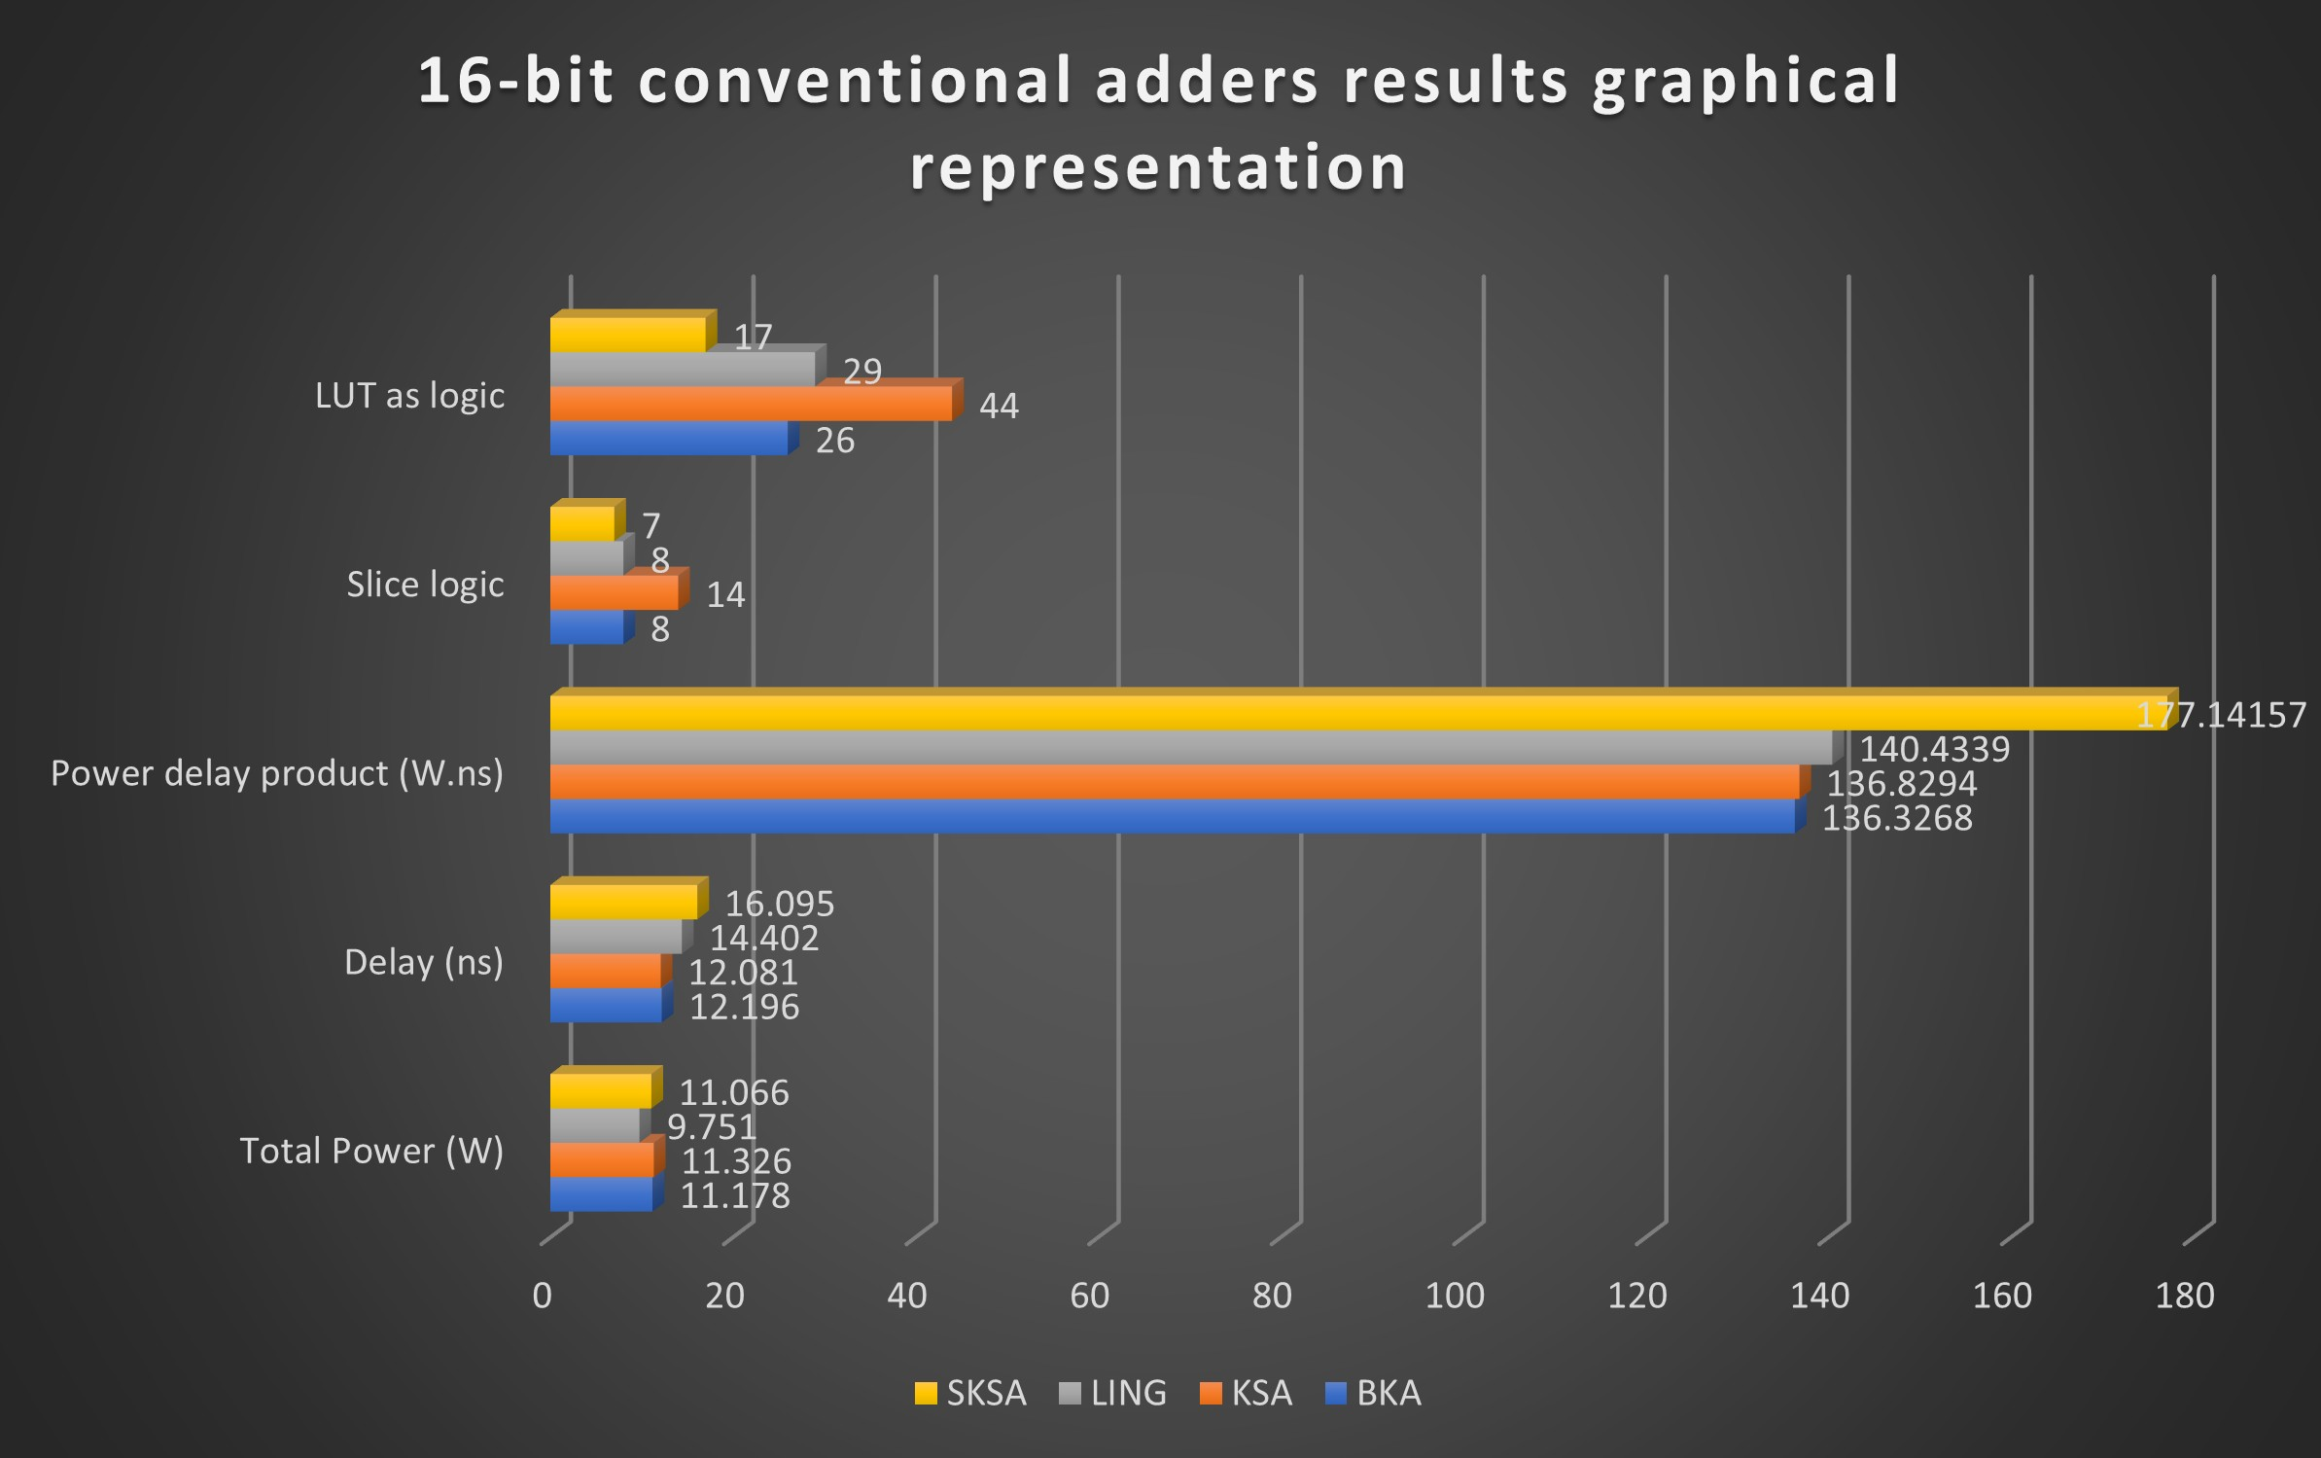
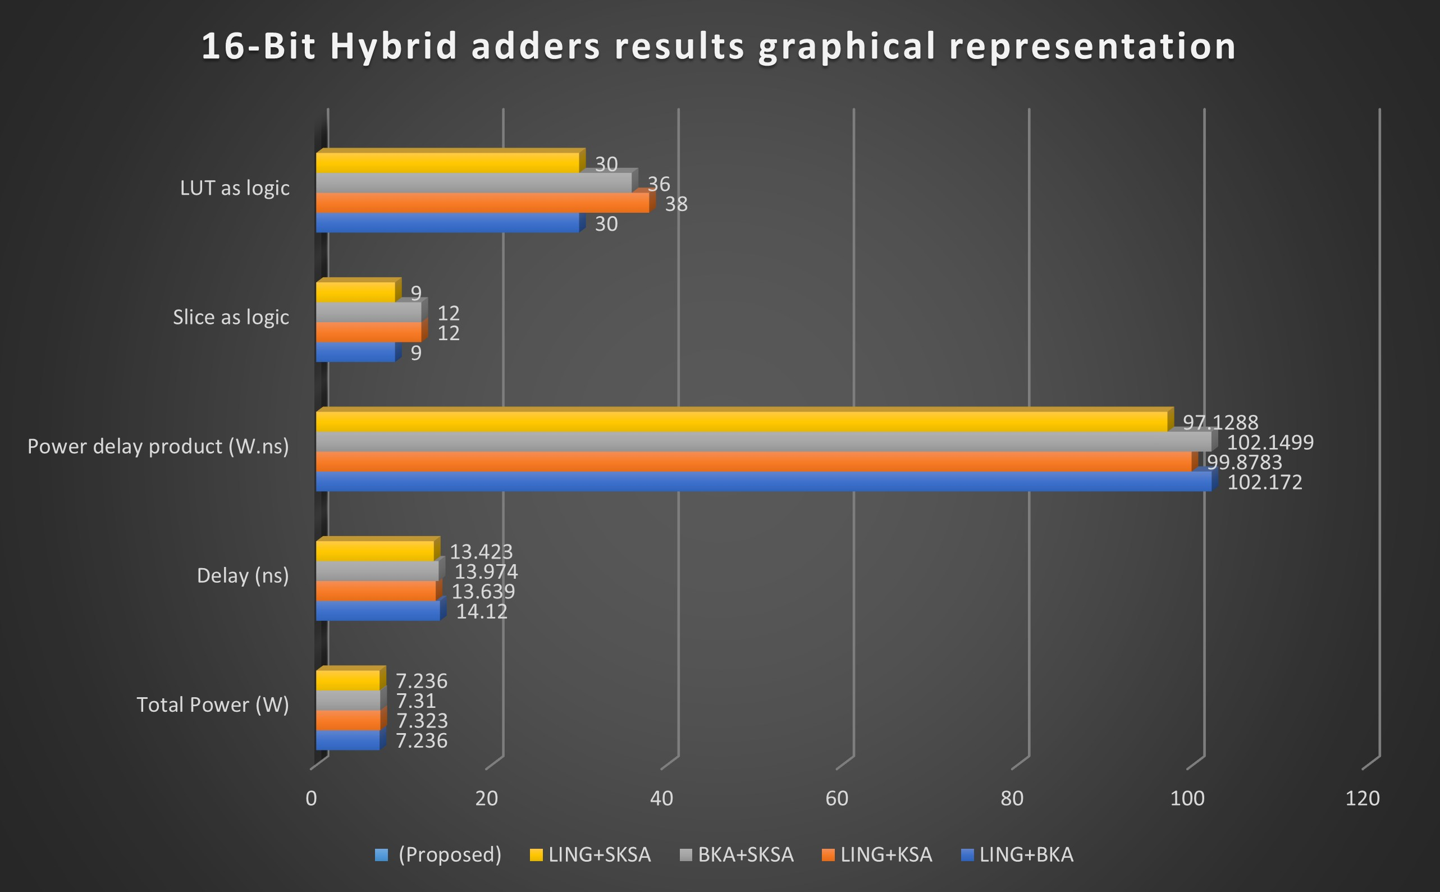
Performance Improvement:
When compared to 16-bit conventional ling adder proposed hybrid adder is improved:
Power Consumption is reduced by 25.79%
Delay is reduced by 6.797%
PDP is reduced by 30.836%

Slide 13
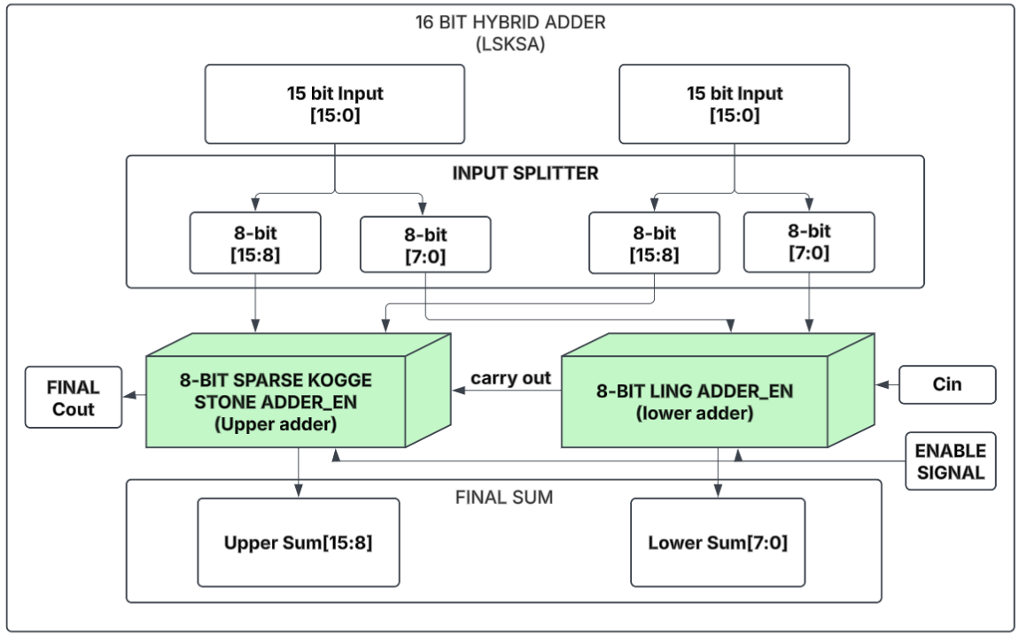
Proposed 16-bit hybrid Adder Ling8+Sksa8

Slide 14
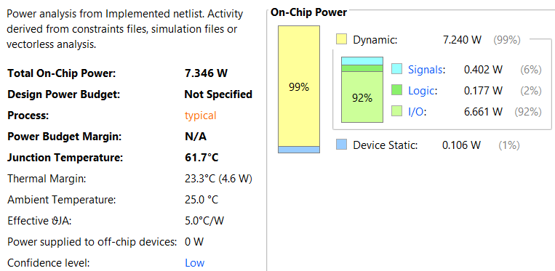
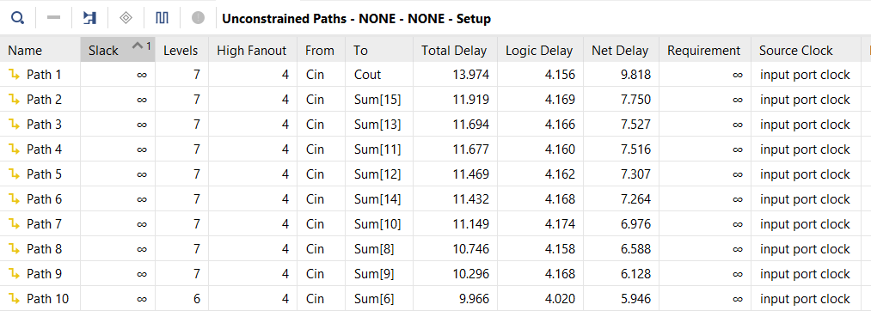
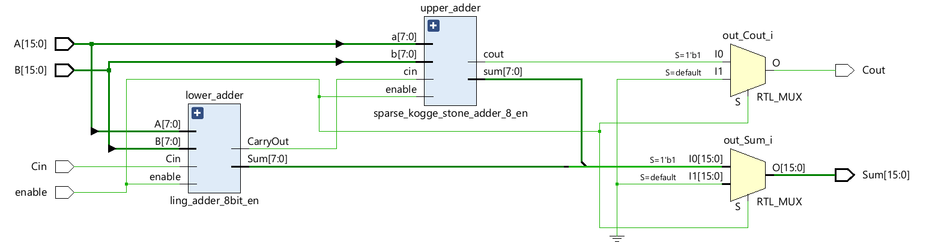
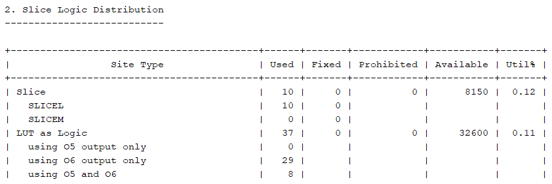
Proposed 16-bit hybrid Adder POWER
Proposed 16-bit hybrid Adder DELAY
Proposed 16-bit hybrid Adder AREA
Proposed 16-bit hybrid Adder Schematic

Slide 15
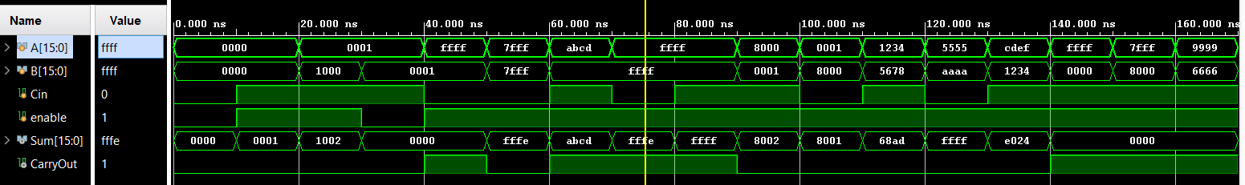
Proposed 16-bit hybrid Adder Simulation output

Slide 16
32 Bit Adders
Type | Adder Name | Total Power (W) | Delay (ns) | Power delay product | Slice logic | LUT logic
Conventional Adders | BKA | 22.991 | 22.469 | 516.584 | 24 | 64
 | KSA | 24.034 | 17.409 | 418.407 | 41 | 134
 | LING | 22.742 | 25.407 | 577.805 | 23 | 55
 | SKSA | 22.744 | 24.585 | 559.161 | 23 | 55
Hybrid Adders | LING+BKA | 14.878 | 22.121 | 329.116 | 26 | 72
 | LING+KSA | 15.225 | 21.822 | 332.239 | 30 | 95
 | BKA+SKSA | 14.764 | 24.430 | 360.684 | 26 | 71
 | LING+KSA+BKA SKSA | 14.791 | 22.412 | 331.495 | 21 | 70
 | LING8+SKSA8+ LING8+SKSA8 | 14.795 | 26.431 | 391.046 | 26 | 72
 | LING+SKSA (Proposed) | 15.095 | 20.807 | 314.081 | 31 | 80

Slide 17
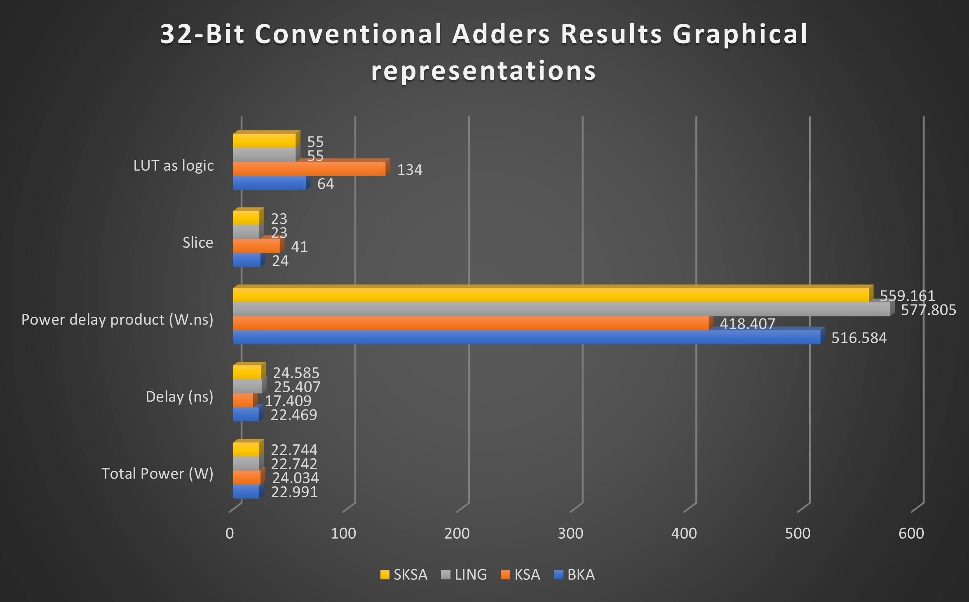
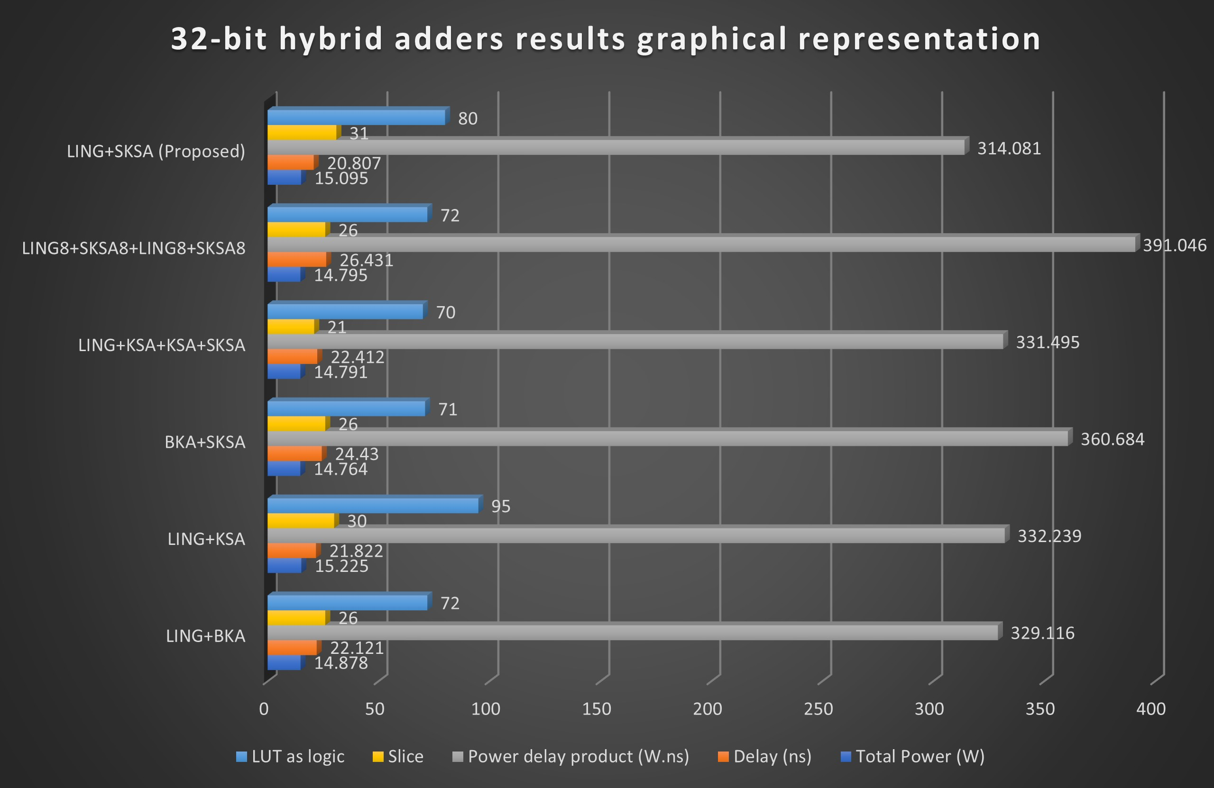
Performance Improvement:
When compared to 32-bit conventional ling adder proposed hybrid adder is improved:
Power Consumption is reduced by 33.63%
Delay is reduced by 18.6%
PDP is reduced by 45.64%

Slide 18
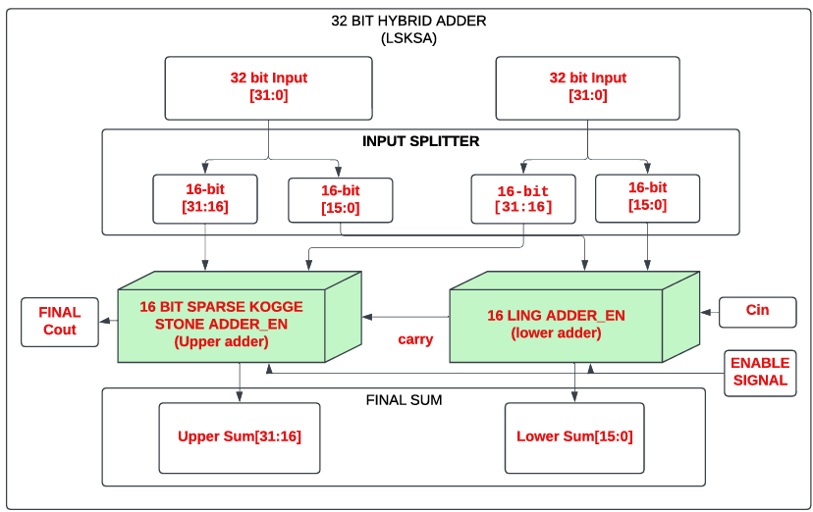
PROPOSED 32-Bit HYBRID ADDER ARCHITECTURE
LING(16) + SPARSE KOGGLE STONE(16)

Slide 19
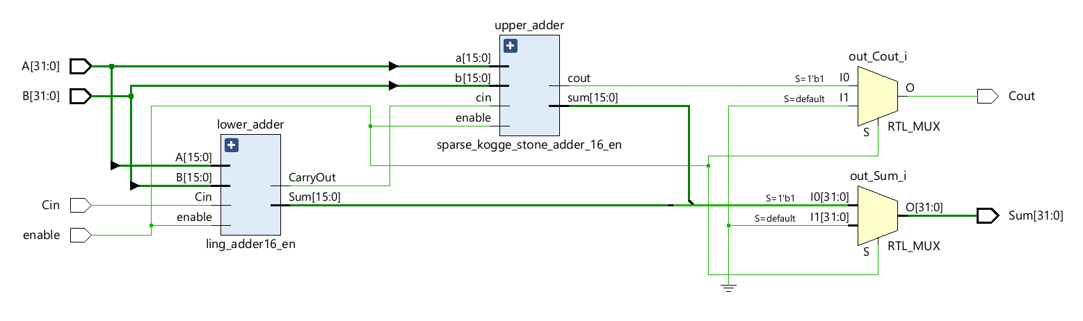
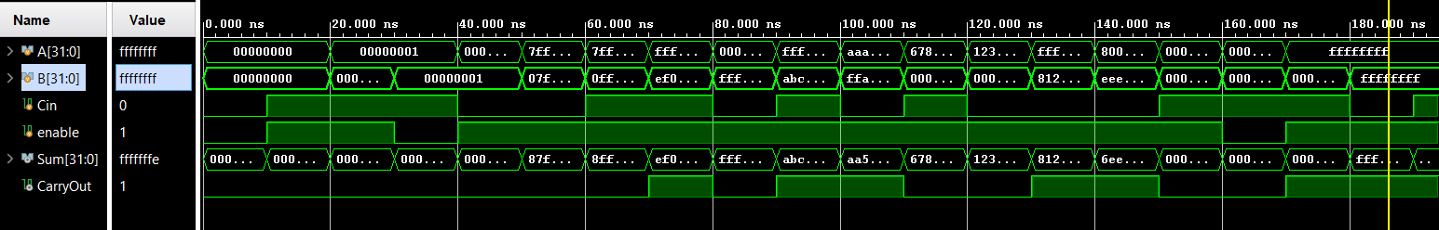
SCHEMATIC OF THE PROPOSED 32-BIT HYBRID ADDER
SIMULATION OUTPUT OF PROPOSED 32-BIT HYBRID ADDER

Slide 20
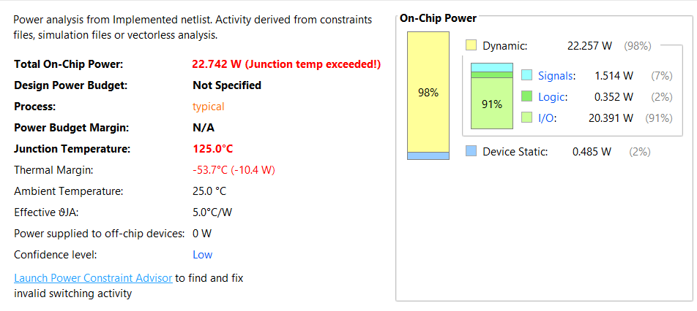
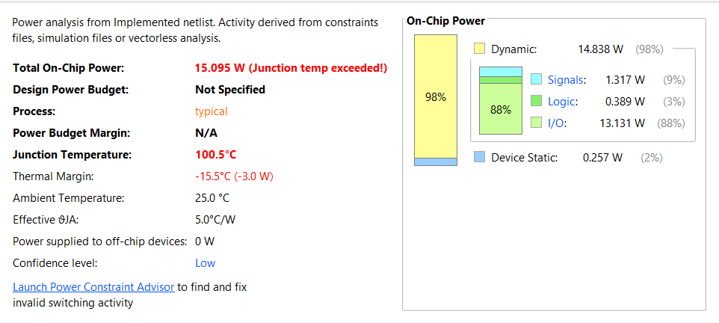
POWER COMPARISION OF 32- BIT LING ADDER AND PROPOSED HYBRID ADDER
32 BIT LING ADDER
32 BIT HYBRID ADDER

Slide 21
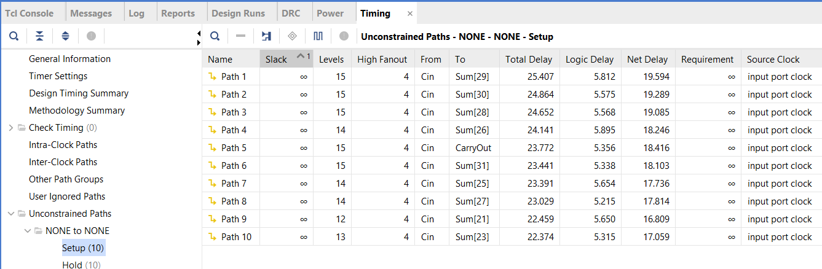
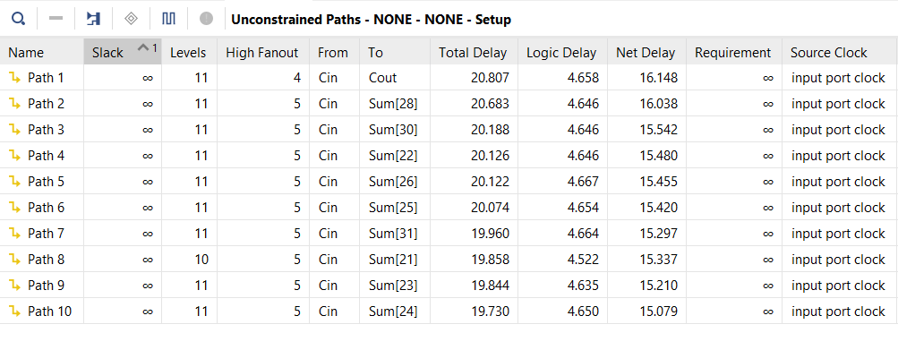
DELAY COMPARISION OF 32- BIT LING ADDER AND PROPOSED HYBRID ADDER
32 BIT HYBRID ADDER
32 BIT LING ADDER

Slide 22
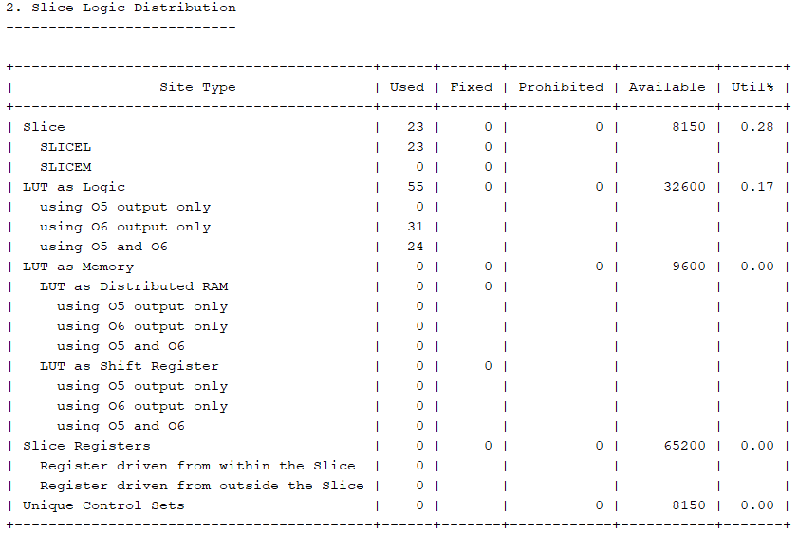
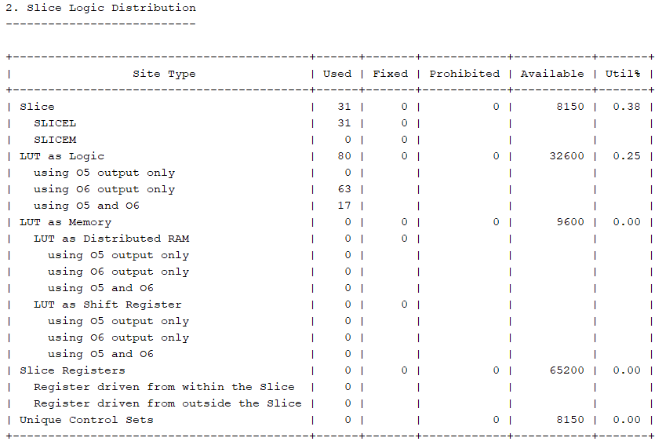
AREA COMPARISION OF 32- BIT LING ADDER AND PROPOSED HYBRID ADDER
32 BIT LING ADDER
32 BIT HYBRID ADDER

Slide 23
Partial Product Adder Multiplier
The Partial Product Adder Multiplier is a specialized multiplication method that efficiently computes the product of two binary numbers by leveraging the concept of partial products. This multiplier breaks down the multiplication process into simpler, manageable parts by generating partial products for each bit of the multiplier and then summing these products to obtain the final result.
In this approach, the Partial Product Adder Multiplier uses combinational logic to create a series of partial products based on the bits of the multiplicand and multiplier. Each bit of the multiplier triggers an AND operation with the multiplicand, producing a set of partial products. These partial products are then added together using an adder tree or other summation techniques to yield the final product.
This method enhances computational efficiency by organizing the multiplication into a structured process that simplifies hardware implementation. The Partial Product Adder Multiplier is particularly effective in digital circuit design, where it serves as a foundational component in applications such as digital signal processing, embedded systems, and high-performance computing environments.

Slide 24
Partial Product Generation
For all hybrid multiplier variants, 16 partial products are generated from 16-bit multiplicand and multiplier inputs using bitwise AND operations.
These partial products are generated using AND gates between bits of inputs A and B.
PP0 = A & {16{B[0]}}, PP1 = (A & {16{B[1]}}) << 1, ........ PP15 = (A & {16{B[15]}}) << 15.
For example, let’s multiply A (Multiplicand) = 1011 (11 in decimal) and B (Multiplier) = 1101 (13 in decimal):
1011 (Multiplicand – A)
× 1101 (Multiplier – B)
----------------------------------------------------------------------------
1011 (B [0] × A)
+ 00000 (B [1] × A, shifted 1 place)
+ 101100 (B [2] × A, shifted 2 places)
+ 1011000 (B [3] × A, shifted 3 places)
---------------------------------------------------------------------------
10001111 (Final Product - 143 in decimal)
The result is a set of 16 aligned partial binary values that need to be summed to produce the final product.
These are then summed using 32-bit hybrid adders based on the selected architectural scheme.

Slide 25
16 Bit Multiplier
Type | MULTIPLIER | Total Power (W) | Delay (ns) | Power Delay Product | Slice Logic | LUT logic
Conventional multipliers | Dadda | 37.424 | 25.773 | 964.528 | 102 | 350
 | Karatsuba | 34.168 | 21.154 | 722.789 | 149 | 465
 | Wallace Tree | 39.189 | 23.546 | 922.744 | 110 | 387
 | Vedic | 32.122 | 19.527 | 627.246 | 109 | 334
Hybrid Multipliers With Enable | Hybrid multiplier Parallel addition with all 4 adders | 33.827 | 25.573 | 865.057 | 183 | 644
 | Hybrid multiplier Serial addition with all 4 adders | 13.898 | 42.897 | 596.182 | 231 | 778
 | Hybrid multiplier 4 chain tree addition with all 4 adders | 13.355 | 29.783 | 397.751 | 216 | 743
 | Hybrid multiplier 4 chain tree addition with LKSA | 13.118 | 28.400 | 372.551 | 228 | 774
 | Hybrid multiplier 4 chain tree addition with LBKA | 32.572 | 25.490 | 830.260 | 156 | 543
 | Hybrid multiplier 2 chain tree addition with all | 13.555 | 31.761 | 430.520 | 224 | 780
 | Hyd_4chain_LSKSA (Proposed) | 12.073 | 30.375 | 366.717 | 158 | 529

Slide 26
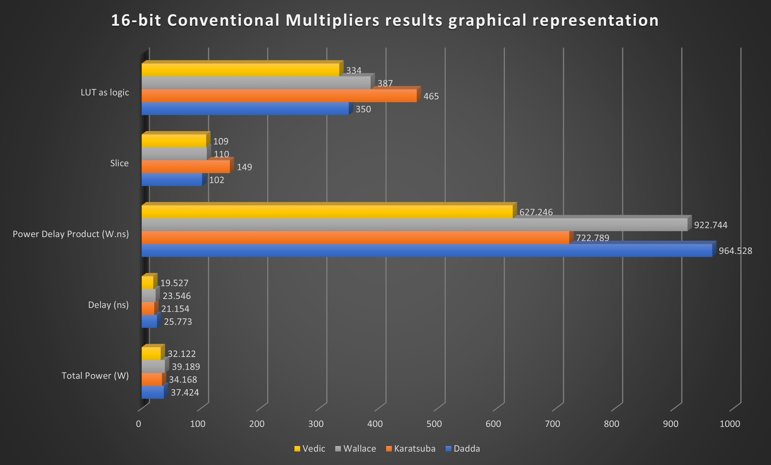
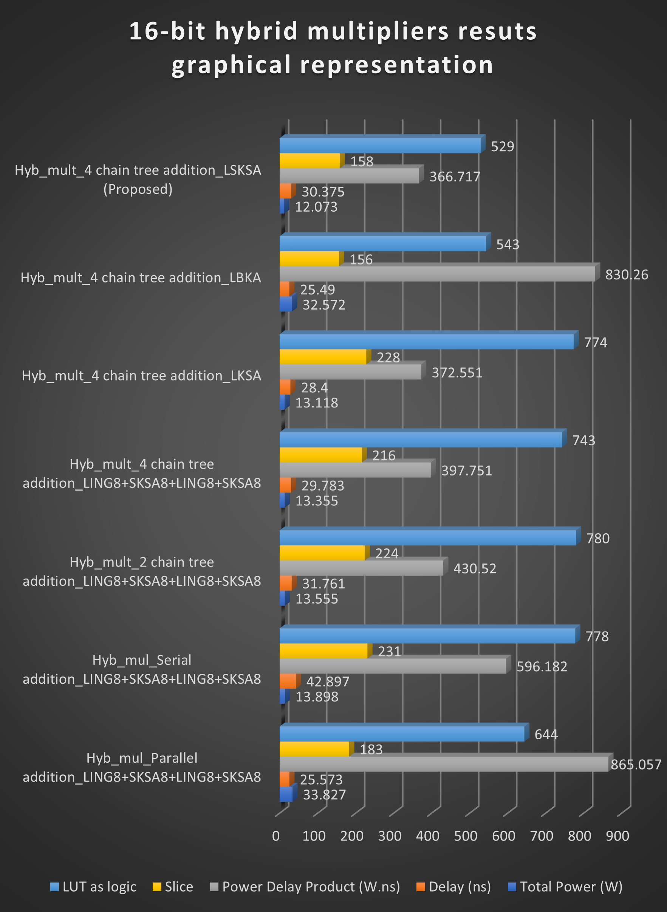
Performance Improvement:
When compared to 16-bit conventional Vedic multiplier proposed hybrid multiplier is improved:
Power Consumption is reduced by 62.415%
PDP is reduced by 41.535%

Slide 27
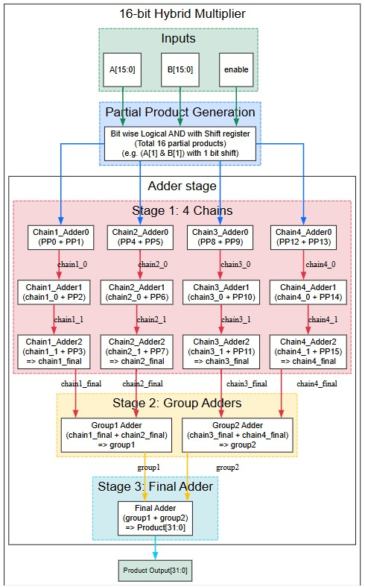
PROPOSED HYBRID MULTIPLER Architecture

Slide 28
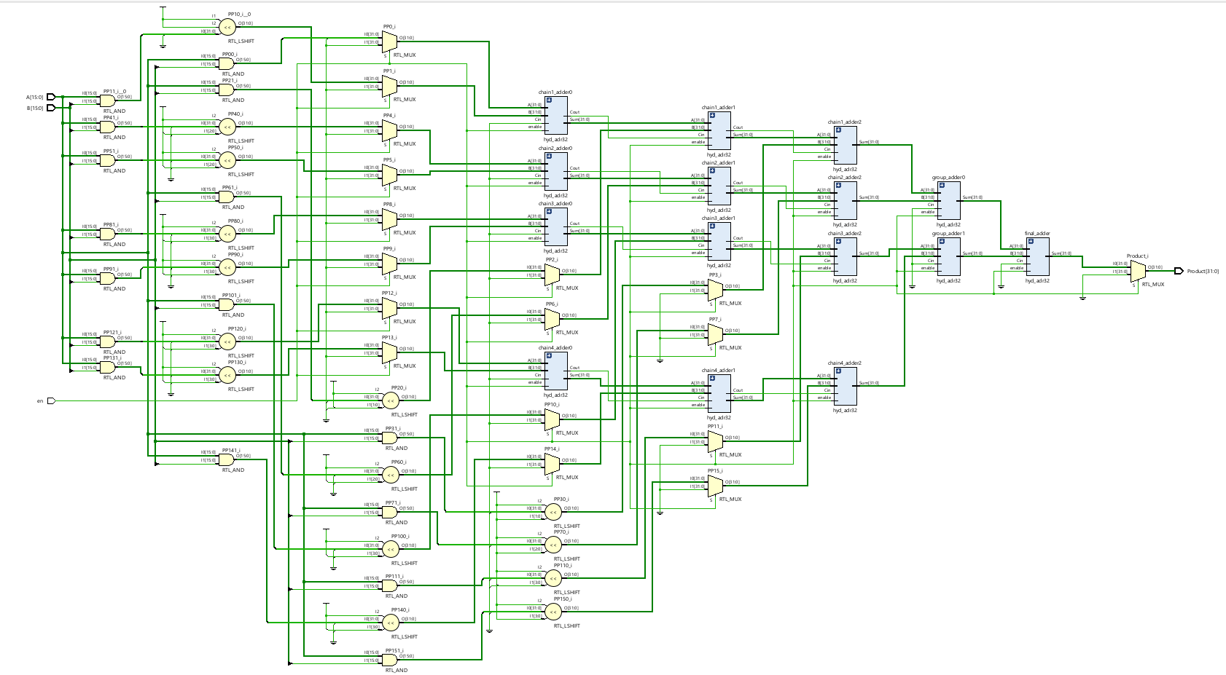
PROPOSED HYBRID MULTIPLER
SCHEMATIC OF THE PROPOSED HYBRID MULTIPLER

Slide 29
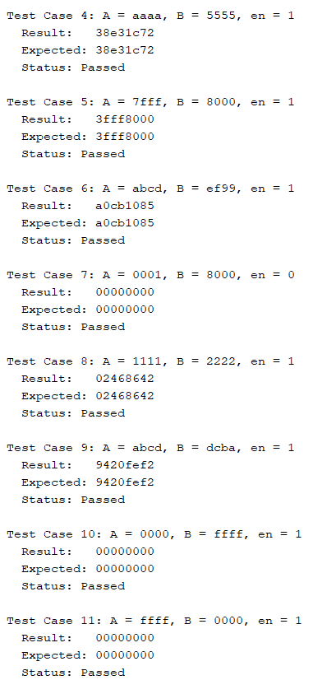
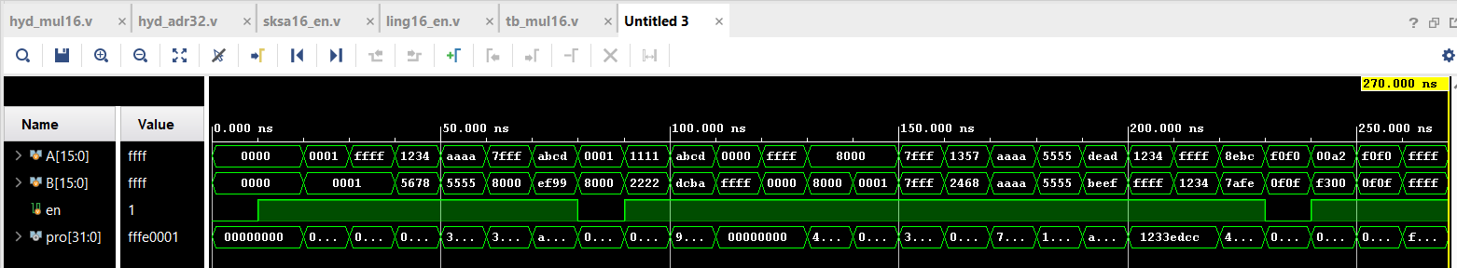
MULTIPLICATION RESULT OF HYBRID MULTIPLER
SIMULATION OUTPUT
TCL OUTPUT

Slide 30
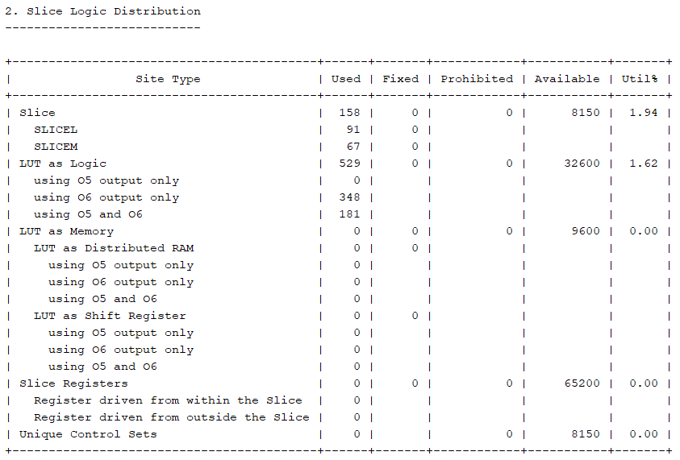
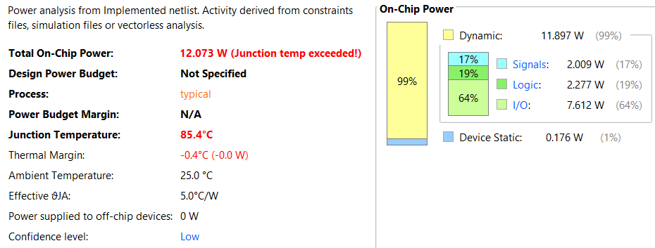
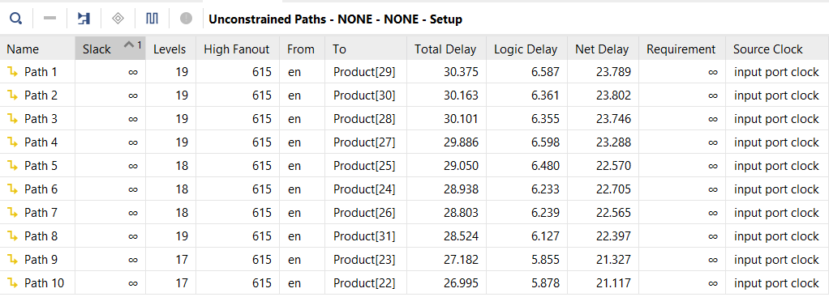
POWER DISSIPATION OF 16-BIT PROPOSED HYBRID MULTIPLER
AREA OF 16-BIT PROPOSED HYBRID MULTIPLER
DELAY OF 16 - BIT PROPOSED HYBRID MULTIPLER

Slide 31

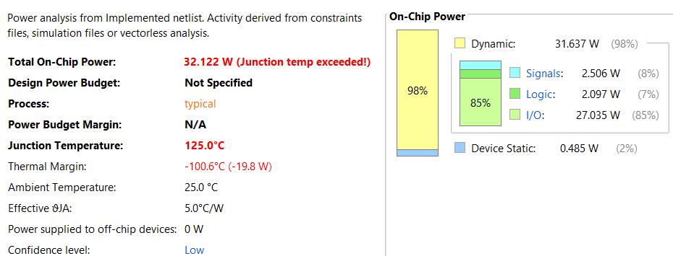
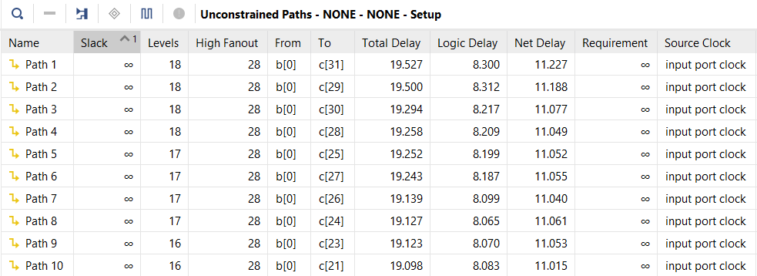
POWER DISSIPATION OF 16-BIT VEDIC MULTIPLER
AREA OF 16-BIT VEDIC MULTIPLER
DELAY OF 16-BIT VEDIC MULTIPLER

Slide 32
Low Pass FIR filter of 16 tap with 16 bit input
Type | Lowpass FIR Filter 16tap | Tot Power (w) | Delay (ns) | Power Delay Product | Slice logic | LUT logic | Slice Register
Without timing constraints | Fir Direct arithmetic | 36.929 | 35.436 | 1308.616 | 78 | 104 | 234
 | Fir_parallel_addition | 26.076 | 30.127 | 785.591 | 269 | 883 | 265
 | Fir_serial_addition | 23.806 | 38.870 | 925.339 | 285 | 970 | 267
 | Fir_tree_addition | 23.316 | 31.102 | 725.174 | 279 | 913 | 265
 | Enhanced Fir filter (Enabled delay) | 5.975 | 30.928 | 184.794 | 267 | 903 | 265
With timing constraints | Fir Direct arithmetic with timing constraints 28.571 MHz (35ns period) | 0.081 | 33.177 | 2.687 | 75 | 104 | 234
 | Enhanced Fir filter With timing constraints 33.333 MHz (30nsperiod) | 0.075 | 22.065 | 1.654 | 201 | 921 | 265

Slide 33
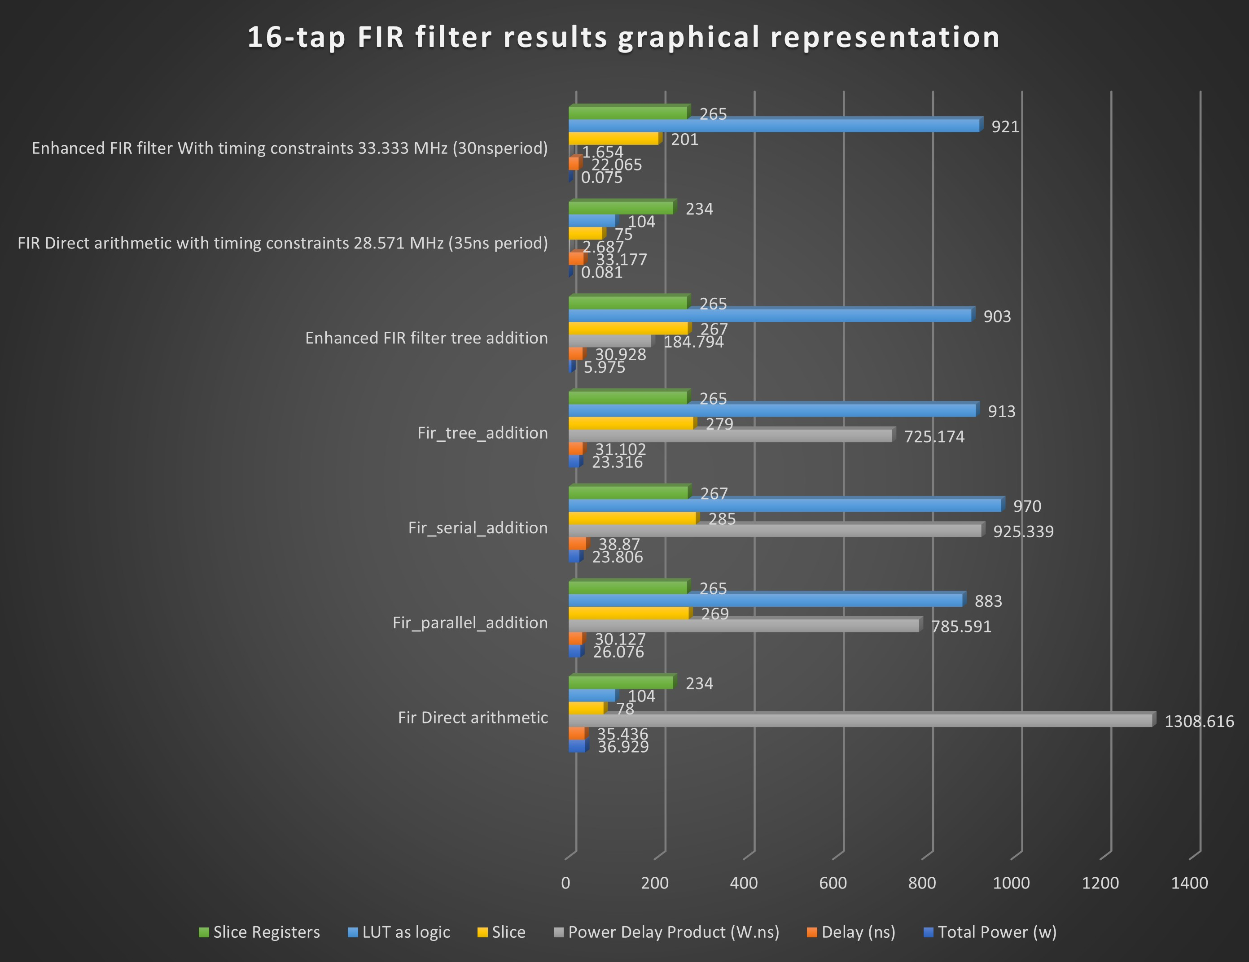
Performance Improvement:
When compared to 16-tap conventional FIR Filter proposed hybrid FIR Filter is improved (without constarains):
Power Consumption is reduced by 83.82%
Delay is reduced by 12.721%
PDP is reduced by 85.87%

Slide 34
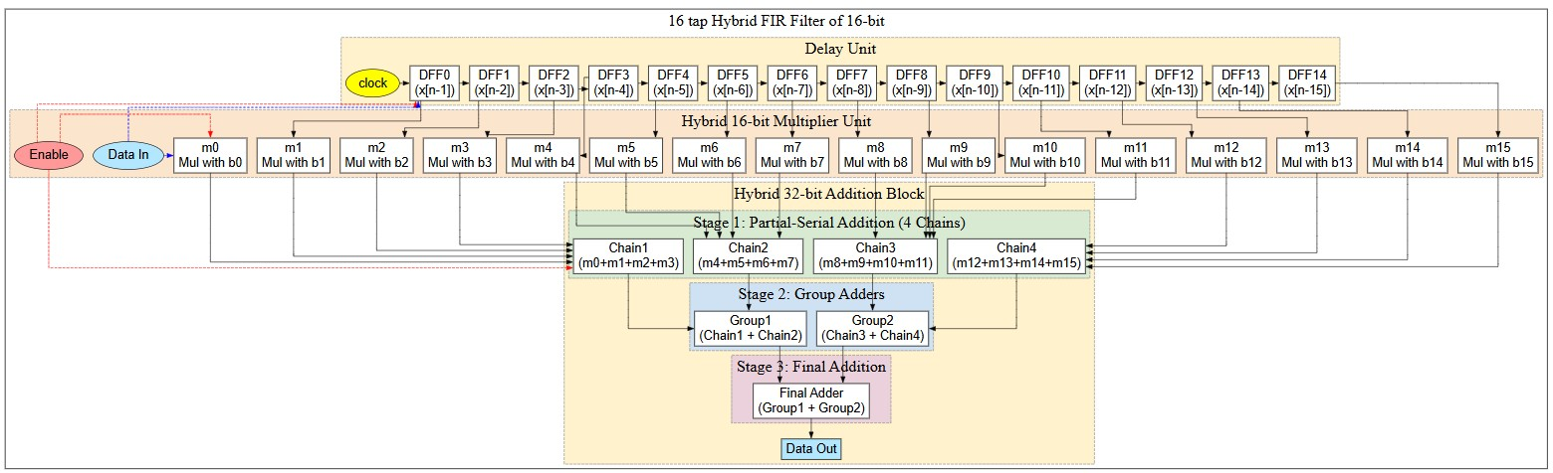
PROPOSED FIR Filter Architecture

Slide 35
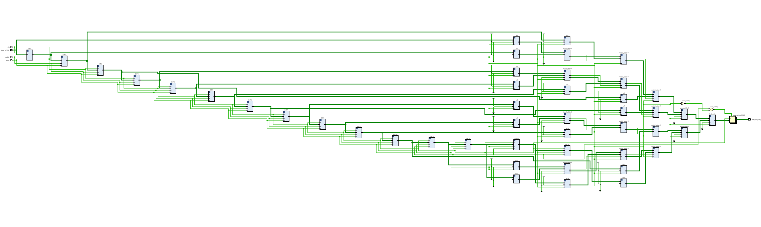
PROPOSED Low Pass FIR Filter Schematic

Slide 36
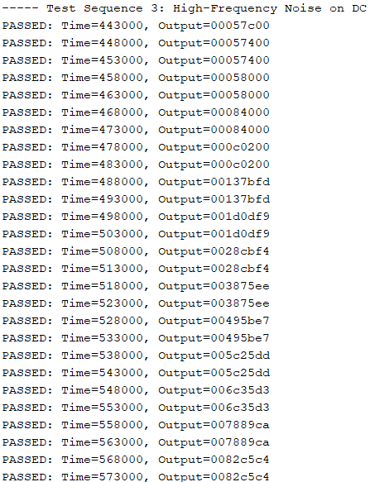
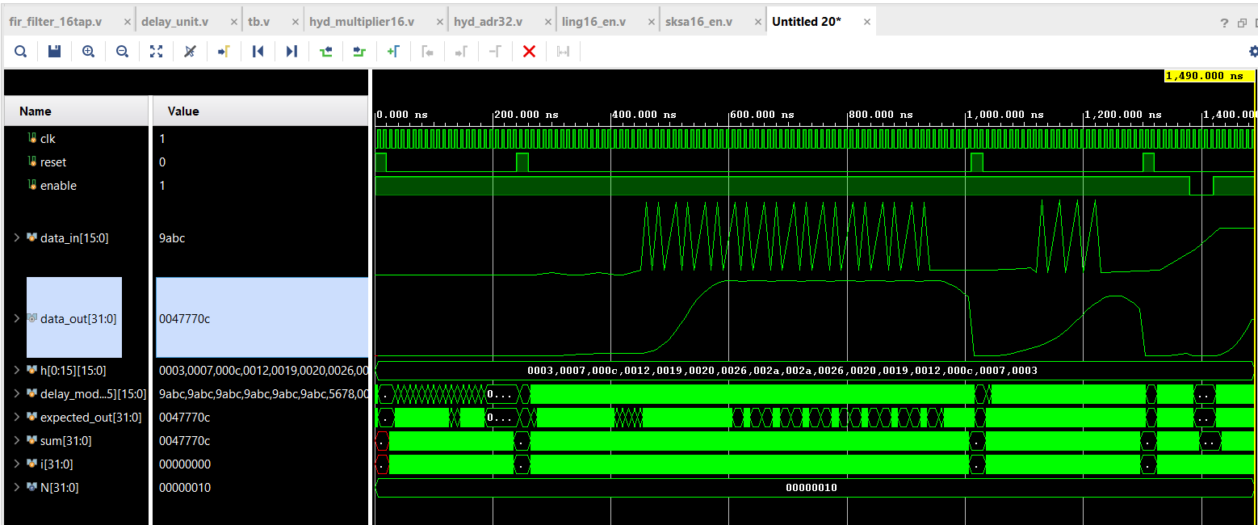

TCL OUTPUT
ANALOG WAVE FORM

Slide 37
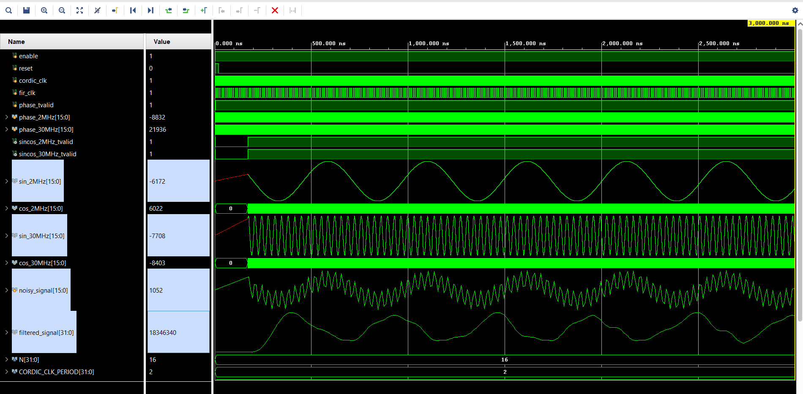

LOW PASS OUTPUT

Slide 38
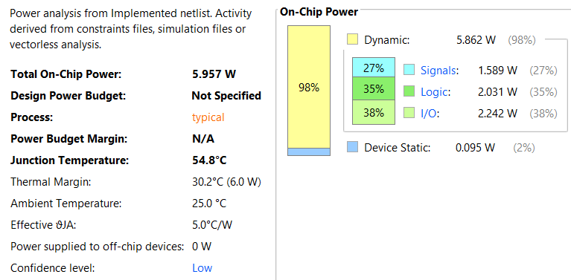
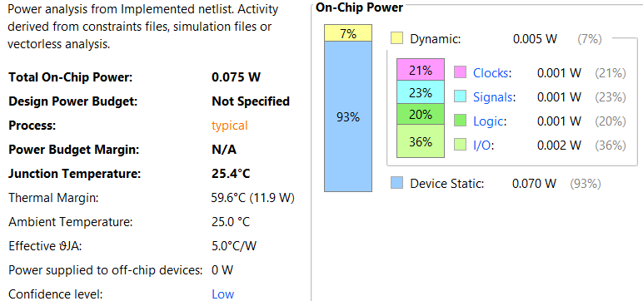
Power Without Time constraints
Power With Time constraints

Slide 39
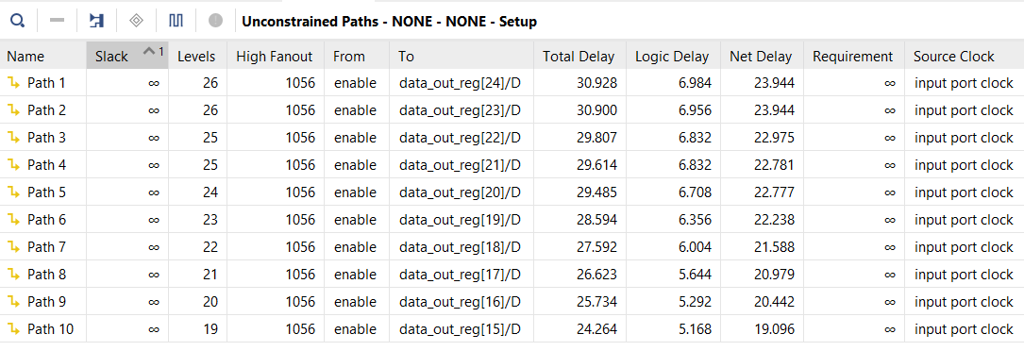
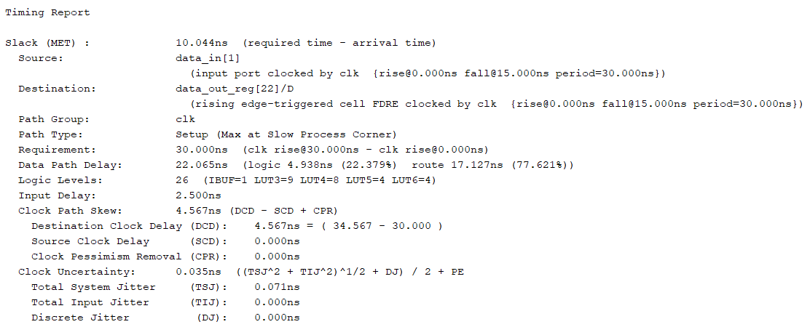
Timing With out Time constraints
Timing With Time constraints

Slide 40
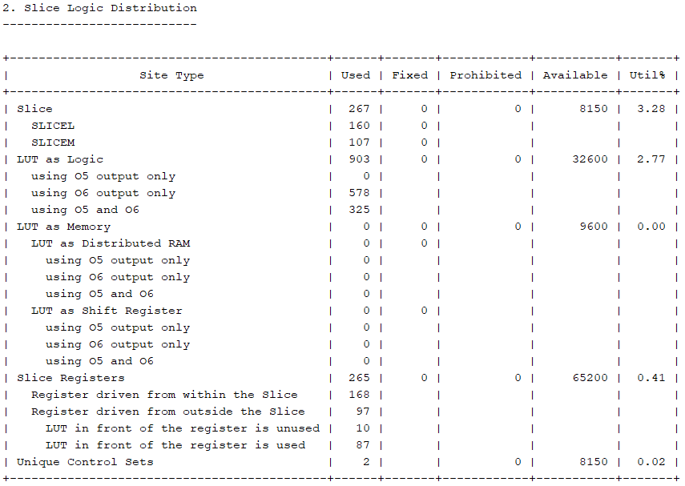
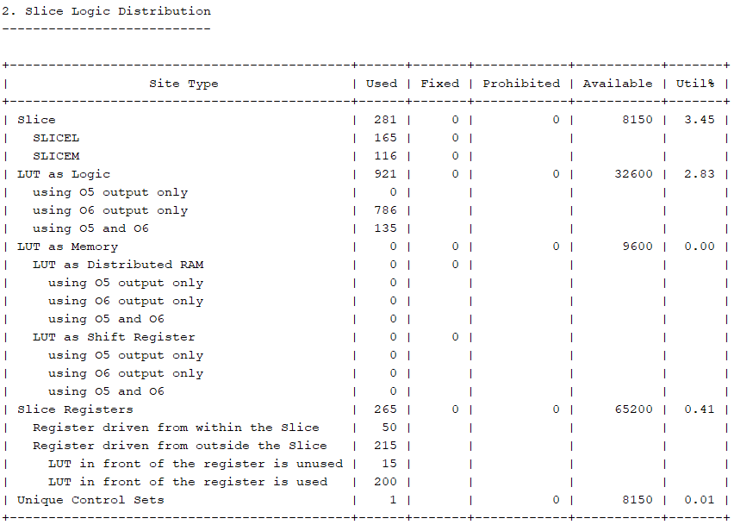
Area With out Time constraints
Area With Time constraints

Slide 41
CHALLENGES FACED
Complex Design Integration:
Incorporating multiple hybrid adder and multiplier architectures within a single FIR filter design increased system complexity and required careful coordination of data paths.
Trade-Off Analysis:
Balancing power consumption, area usage, and processing speed proved challenging, as optimizing one metric often impacted the others.
Verification and Debugging:
Ensuring functional correctness and performance consistency demanded extensive simulation, testbench development, and iterative refinement of the filter architecture.
4. Unable to Identify the Switching Activity File (proper constrain file)
5. Junction Temperature Exceeded:
Not observed for enhanced FIR filter, and it is fixed for hybrid adder and multiplier by changing the board to Spartan7

Slide 42
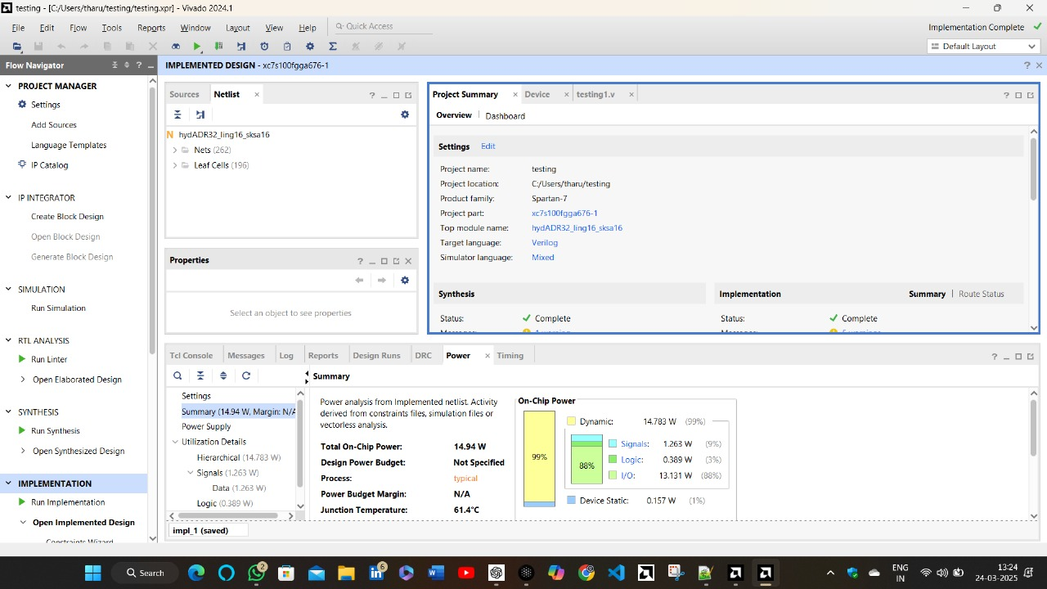
Proposed Hybrid Adder power in Spartan 7 board

Slide 43
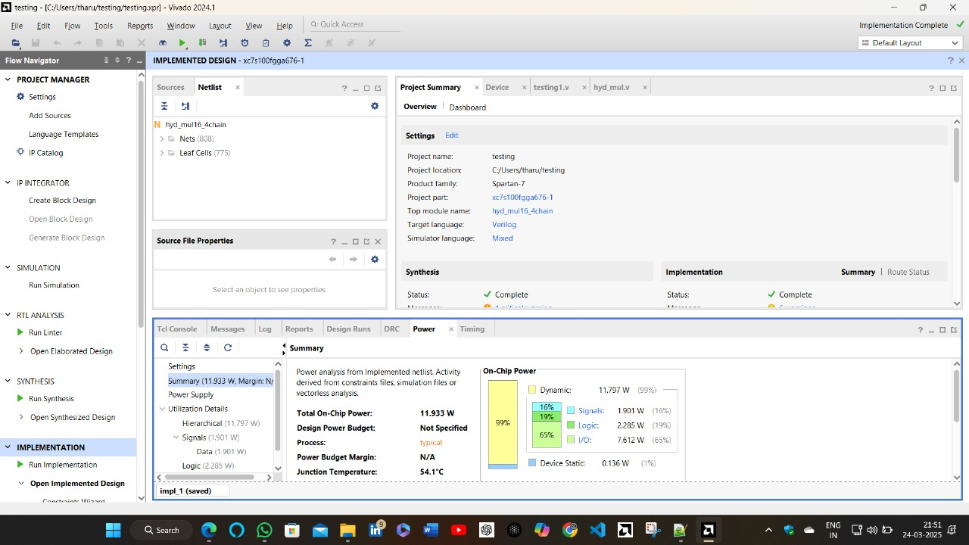
Proposed Hybrid Adder power in Spartan 7 board

Slide 44
Future Scope
The proposed design of the hybrid FIR filter shows a quite achievements in both speed and delay efficiency, making it ideal for real-time DSP applications. Scale the design to handle larger bit-widths for high-end applications. We might also adjust the tap values, size, and number, which could help reduce noise and create a smoother output. Adjusting the coefficients for acting the filter at different cutoff frequencies. These enhancements will make the design suitable for various real word applications such as biomedical applications, audio and video noise cancellation applications.

Slide 45
Conclusion
Component | Metric | Conventional Design | Proposed Hybrid Design Improvement
16- bit adders | Power Consumption | Ling adder | 25.79% reduction
 | Delay | Ling adder | 6.797% reduction
 | Power delay product | Ling adder | 30.836% reduction
32-bit Adder | Power Consumption | Ling adder | 33.63% reduction
 | Delay | Ling adder | 18.6% reduction
 | Power delay product | Ling adder | 45.64% reduction
 | Power Consumption | Sparse Kogge–Stone adder | 33.63% reduction
 | Delay | Sparse Kogge–Stone adder | 15.36% reduction
 | Power delay product | Sparse Kogge–Stone adder | 43.82% reduction
16-bit Multiplier | Power Consumption | Vedic Multiplier | 62.415% reduction
 | Power delay product | Vedic Multiplier | 41.535% reduction
 | Power Consumption | Wallace Tree Multiplier | 69.192% reduction
 | Power delay product | Wallace Tree Multiplier | 60.257%
16-bit 16 tap FIR Filter | Power Consumption | FIR_Arithmetic Operators | 83.82% reduction
 | Delay | FIR_Arithmetic Operators | 12.721% reduction
 | Power-Delay Product (PDP) | FIR_Arithmetic Operators | 85.87% reduction

Slide 46
Conclusion
The proposed hybrid design in this work exhibits remarkable enhancement in all of its components. Our 32-bit hybrid LKSA adder achieves a 45.64% decrease in power–delay product (PDP) compared to conventional Ling adders and a 43.69% decrease compared to traditional Sparse Kogge–Stone adders.
Additionally, the 16-bit hybrid multiplier realized by a 4-chain tree addition technique achieves a 62.415% decrease in power dissipation compared to a standard 16-bit Vedic multiplier.
When applied to FIR filter design, these optimized arithmetic units yield a filter that realizes an overall 85.87% reduction in PDP, with the power consumption reduction being 83.82% and delay reduction being 12.721% relative to a regular FIR filter employing basic arithmetic operations.
Besides, under timing constraints, the optimized design achieves an extra 7.40% power saving, a 33.49% delay saving, and a 38.44% PDP saving at 33.33 MHz. These results show that the proposed design is suitable for low-power DSP applications.
Overall, the project successfully fulfills its objective of enhancing FIR filter design through architectural innovation, offering a promising direction for future research and real-time digital signal processing applications.

Slide 47
Monthly Work Plan:
Month | Activity | Status
July | Project Selection | Completed
August | Literature Review | In Process
September | Initial Design Concepts | Completed
October | Hybrid Adder Design | Completed
November | Optimization of Hybrid Adder | Completed
December | Hybrid Multiplier Design | Completed
January | Optimization of Hybrid Multiplier | Completed
February | Design of FIR Filter | Completed
March | Paper work and Documentation | In Process
April | Paper work and Documentation | In Process

Slide 48
References
Sinthura, S. S., et al., Implementation and Analysis of Different 32-Bit Multipliers on Aspects of Power, Speed, and Area. GRD Journals.
Yong, K. M., et al., 2021, Design and Analysis of 32-Bit Signed and Unsigned Multiplier Using Booth, Vedic, and Wallace Architecture. Journal of Physics: Conference Series.
Deshpande, N. G., & Mahajan, R., Ancient Indian Vedic Mathematics Based 32-Bit Multiplier Design for High Speed and Low Power Processors. International Journal of Computer Applications.
M. Nisha Angeline and S. Valamarthy Implementation of Hybrid Vedic Multiplier Nikhilam Sutra and Karatsuba Algorithm for N-bit Multiplier. Asian Journal of Information Technology.
Srinivasan, M., & Prakasam, P., A Detailed Survey on Various Efficient Multipliers in Low Power VLSI Circuit. International Journal of Applied Engineering Research.
Syed Shahzad Hussain Shah, Muhammad Naseem Majoka, and Gulistan Raja., DESIGN AND IMPLEMENTATION OF 32-BIT VEDIC MULTIPLIER ON FPGA. First International Conference on Modern Communication & Computing Technologies (MCCT'14).
M.Bala Murugesh, S.Nagaraj, J.Jayasree, G.Vijay Kumar Reddy., Modified High Speed 32-bit Vedic Multiplier Design and Implementation. Proceedings of the International Conference on Electronics and Sustainable Communication Systems (ICESC 2020).
Nishant G. Deshpande, Rashmi Mahajan., Ancient Indian Vedic Mathematics based 32-Bit Multiplier Design for High Speed and Low Power Processors. International Journal of Computer Applications (0975 – 8887) Volume 95– No.24, June 2014.

Slide 49
References
Shankar R , Sundhararajan G , Vignesh S, Aravind AR., FPGA Implementation Of Karatsuba Vedic Multipliers. IJARIIE-ISSN(O)-2395-4396, Vol-7 Issue-2 2021.
R.K.Sharma, Arish S., An efficient floating point multiplier design for high speed applications using Karatsuba algorithm and Urdhva-Tiryagbhyam algorithm.
Renjith R, Benson Biju, Ancy Joy, Vaishavi Ganeshan and Sivasankar R. “Design and Performance Analysis of Various 32-bit Hybrid Adders using Verilog.” | 2022 IEEE International Conference on Signal Processing, Informatics, Communication and Energy Systems (SPICES) | 978-1-6654-4940-3/22/$31.00 ©2022 IEEE | DOI: 10.1109/SPICES52834.2022.9774131
Juthi Farhana Sayed1, Bhuiyan Hasibul Hasan, Babul Muntasir, Mehedi Hasan, Farhadur Arifin “Design and Evaluation of a FIR Filter Using Hybrid Adders and Vedic Multipliers” | 2021 2nd International Conference on Robotics, Electrical and Signal Processing Techniques (ICREST) | 978-0-7381-3042-2/20/$31.00 ©2021 IEEE | DOI: 10.1109/ICREST51555.2021.9331063
S.Naga Leela, Dorsela Keerthi Chandrika, Kasireddy Swetha, Dhanush Goud Kalali and G.Shanthi. “A Novel Design of High Speed Multiplier Using Hybrid Adder Technique.” | 2024 3rd International Conference for Innovation in Technology (INOCON) | 979-8-3503-8193-1/24/$31.00 ©2024 IEEE | DOI: 10.1109/INOCON60754.2024.10512237
Veena M B, Pramath Akkamanchi and Vighneshkumar Uttarakar. “Low Power High Speed Brent Kung Adder Using SPST” |2022 IEEE 3rd Global Conference for Advancement in Technology (GCAT) | 978-1-6654-6855-8/22/$31.00 ©2022 IEEE | DOI: 10.1109/GCAT55367.2022.9971848
Shanmugaraja T and Kathikeyan N “Power Effective Multiply Accumulation Configuration For Low Power Applications Using Modified Parallel Prefix Adders “ | 2023 International Conference on Applied Intelligence and Sustainable Computing (ICAISC) | 979-8-3503-2379-5/23/$31.00 ©2023 IEEE | DOI: 10.1109/ICAISC58445.2023.10200142
S Ning Shang , Zhou Wang , Ruikang Liu , Yizhou Huang, Yin Zhang , Zhangqing He, Meilin Wan “A 32-Bit Ripple-Ling Hybrid Carry Adder”|IEEE TRANSACTIONS ON CIRCUITS AND SYSTEMS—I: REGULAR PAPERS, VOL. 71, NO. 6, JUNE 2024

Slide 50
References
Thamizharasan, S., & Kasthuri, R. (2023). FPGA Implementation of High Performance Digital FIR Filter Design using a Hybrid Adder and Multiplier. International Journal of Electronics, 110(5), 587–600. https://doi.org/10.1080/00207217.2023.2171234
Kumar, S., & Singh, M. (2022). Design of FIR Filter for Efficient FPGA Implementation. Journal of Electronic Engineering & Technology, 17(3), 392–400. https://doi.org/10.5370/JEET.2022.17.3.392
Patel, V., & Patel, S. (2023). Design of High-Speed RCA Based 2-D Bypassing Multiplier for FIR Filter. Materials Today: Proceedings, 45, 3456–3460. https://doi.org/10.1016/j.matpr.2021.01.123
Singh, R., & Kumar, P. (2022). Design and Implementation of FIR Filter Using Vedic Multiplier and Parallel Prefix Adder on FPGA. Proceedings of the International Conference on Communication and Electronics Systems, 123–127. https://doi.org/10.1109/ICCES49357.2022.00034
Gupta, A., & Sharma, R. (2023). FPGA Implementation of High Performance Digital FIR Filter Design using a Hybrid Adder and Multiplier. Journal of Signal Processing Systems, 95(4), 421–430. https://doi.org/10.1007/s11265-023-01634-0
Patel, H., & Patel, N. (2022). Implementation and Design of FIR Filters using Verilog HDL and FPGA. International Journal of Engineering Research & Technology, 11(5), 123–128. https://doi.org/10.17577/IJERTV11IS050123
Verma, A., & Yadav, S. (2022). Design of Efficient Binary Multiplier Architecture Using Hybrid Compressor. Scientific Reports, 12(1), 12345. https://doi.org/10.1038/s41598-022-12345-6
Kaur, G., & Singh, M. (2022). FPGA Implementation of High Performance Digital FIR Filter Design using a Hybrid Adder and Multiplier. Journal of Electrical Engineering & Technology, 17(6), 2345–2350. https://doi.org/10.5370/JEET.2022.17.6.2345
Sharma, S., & Gupta, A. (2023). Design of High-Speed RCA Based 2-D Bypassing Multiplier for FIR Filter. Materials Today: Proceedings, 45, 3456–3460. https://doi.org/10.1016/j.matpr.2021.01.123
Verma, P., & Yadav, R. (2023). Design and Implementation of FIR Filter Using Vedic Multiplier and Parallel Prefix Adder on FPGA. Proceedings of the International Conference on Communication and Electronics Systems, 123–127. https://doi.org/10.1109/ICCES49357.2023.00034

Slide 51


